Slide 1

Enabling Low Bit-Rate MPEG V-PCC-encoded Volumetric Video Streaming with 3D Sub-sampling
Yuang Shi, Pranav Venkatram, Yifan Ding, Wei Tsang Ooi
School of Computing
National University of Singapore
Notes:
Use keynote/ppt

Slide 2
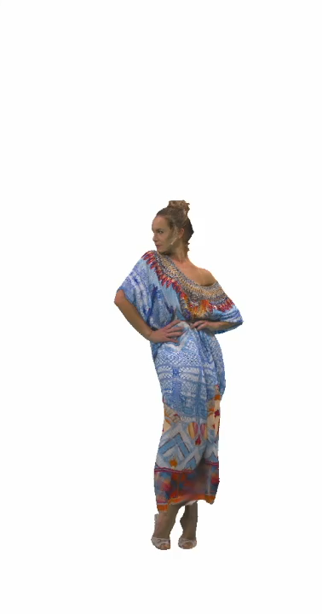
Volumetric Video
Volumetric videos capture actors or subjects in 3D to create holograms that viewers can watch from any conceivable angle
Notes:
Change the video
Volumetric videos capture actors or subjects in 3D to create holograms that viewers can watch from any conceivable angle

Slide 3
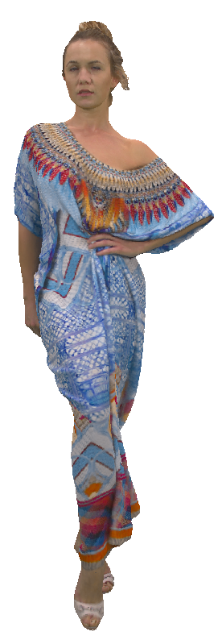
Point Cloud –– Representation of Volumetric Video
This frame is a point cloud
Each point consist of position (X,Y,Z), texture (R, G, B)

Slide 4
Point Cloud –– Representation of Volumetric Video
This frame is a point cloud
Each point consist of position (X,Y,Z), texture (R, G, B)
700K points
18 MB
For a 30 fps volumetric video:
18 MB * 30 fps = 540 MBps

Slide 5
Volumetric Video Compression
MPEG’s Video-based PCC (V-PCC) & Geometry-based PCC (G-PCC), Google’s Draco…
Figure Source: Yang, Mengyu, et al. "A Comparative Measurement Study of Point Cloud-Based Volumetric Video Codecs." IEEE Transactions on Broadcasting (2023).

Slide 6
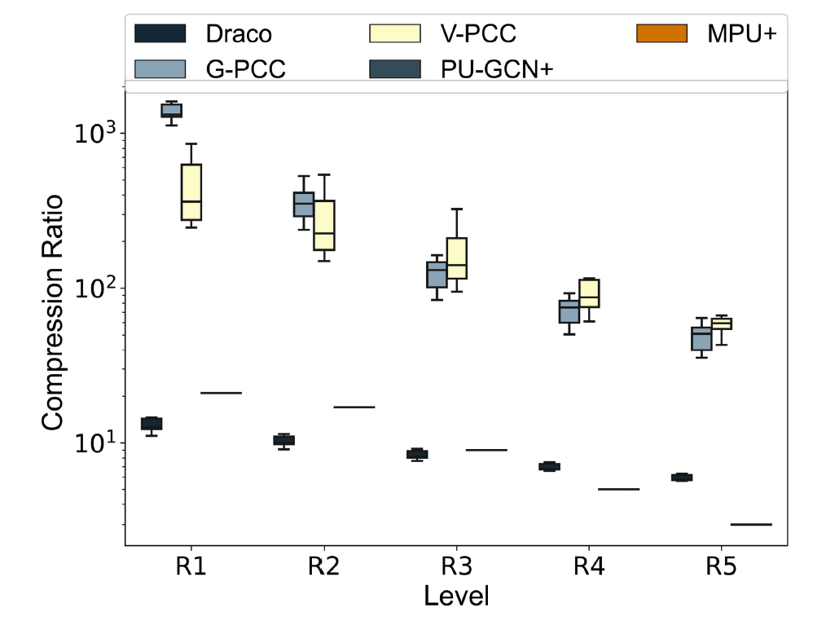
Volumetric Video Compression
MPEG’s Video-based PCC (V-PCC) & Geometry-based PCC (G-PCC), Google’s Draco…
V-PCC shows great potential for the applications of volumetric videos
Figure Source: Yang, Mengyu, et al. "A Comparative Measurement Study of Point Cloud-Based Volumetric Video Codecs." IEEE Transactions on Broadcasting (2023).

Slide 7
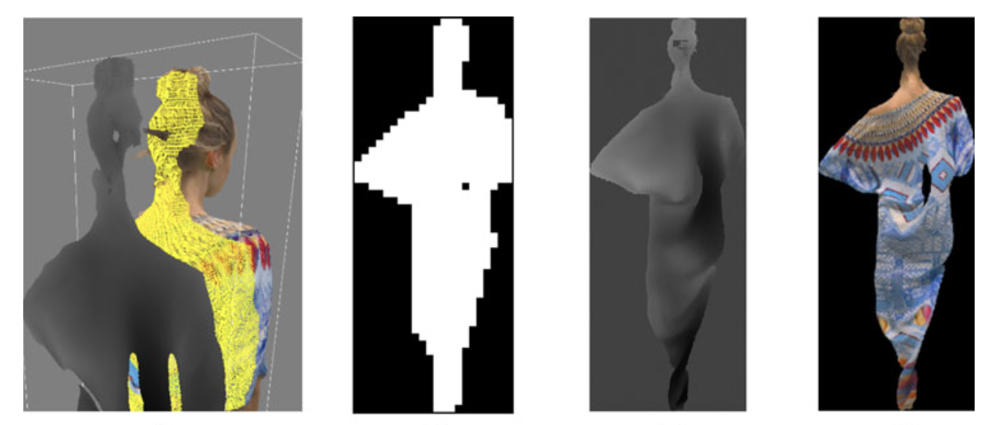
MPEG’s V-PCC
Patch Generation
Occupancy Map
Geometry Map
Attribute Map
Image Source: Graziosi, D., et al. "An overview of ongoing point cloud compression standardization activities: Video-based (V-PCC) and geometry-based (G-PCC)." APSIPA Transactions on Signal and Information Processing 9 (2020): e13.

Slide 8

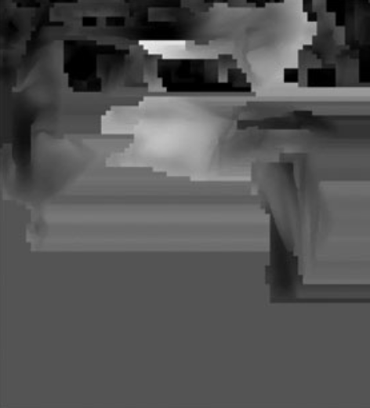
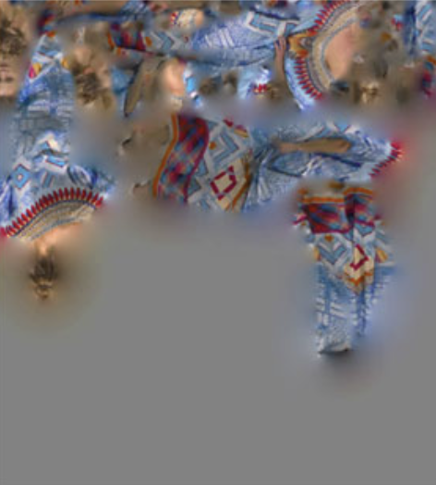
MPEG’s V-PCC
Patch Packing
Video Encoder
2D video encoder, e.g. HEVC / VVC
Occupancy Map
Geometry Map
Attribute Map
packed patches

Slide 9
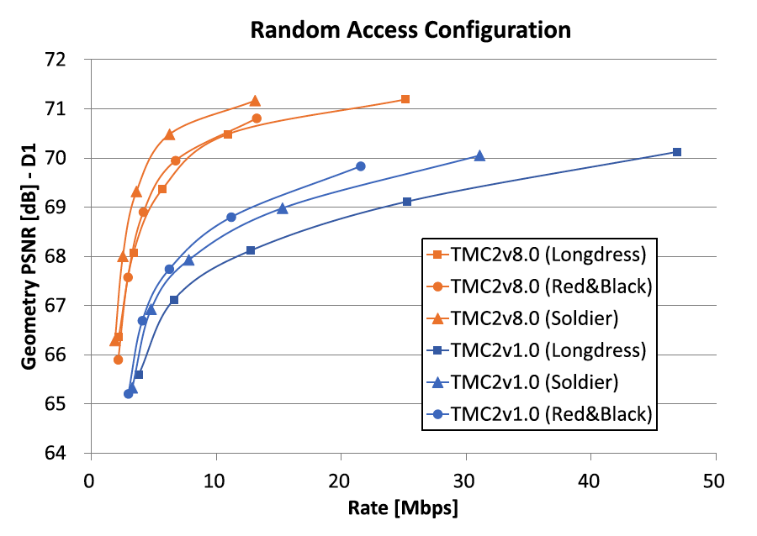
Problem of V-PCC
The performance of V-PCC is highly dependent on the performance of the 2D video codec
State-of-the-art video codecs typically have a bit-rate range that they are designed to operate in
Image Source: Graziosi, D., et al. "An overview of ongoing point cloud compression standardization activities: Video-based (V-PCC) and geometry-based (G-PCC)." APSIPA Transactions on Signal and Information Processing 9 (2020): e13.

Slide 10
Problem of V-PCC
Sharp Drop
The performance of V-PCC is highly dependent on the performance of the 2D video codec
State-of-the-art video codecs typically have a bit-rate range that they are designed to operate in
Image Source: Graziosi, D., et al. "An overview of ongoing point cloud compression standardization activities: Video-based (V-PCC) and geometry-based (G-PCC)." APSIPA Transactions on Signal and Information Processing 9 (2020): e13.

Slide 11
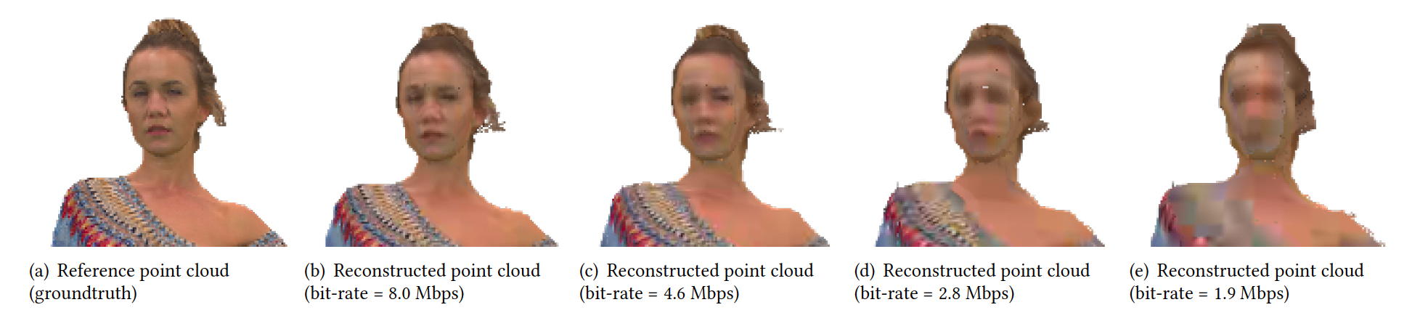
Problem of V-PCC
Notes:
Play a video of (e)

Slide 12
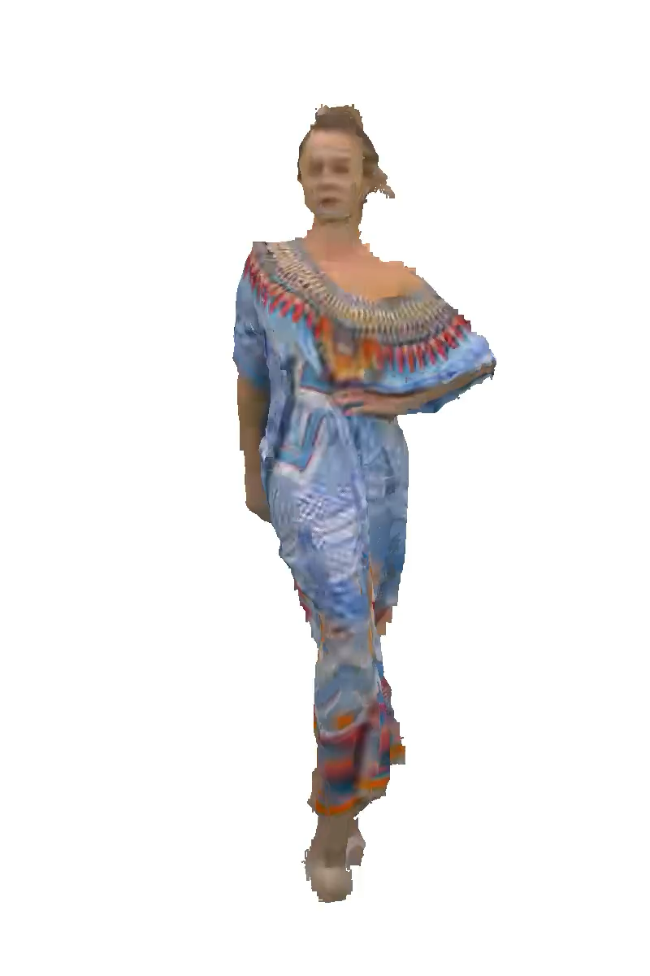
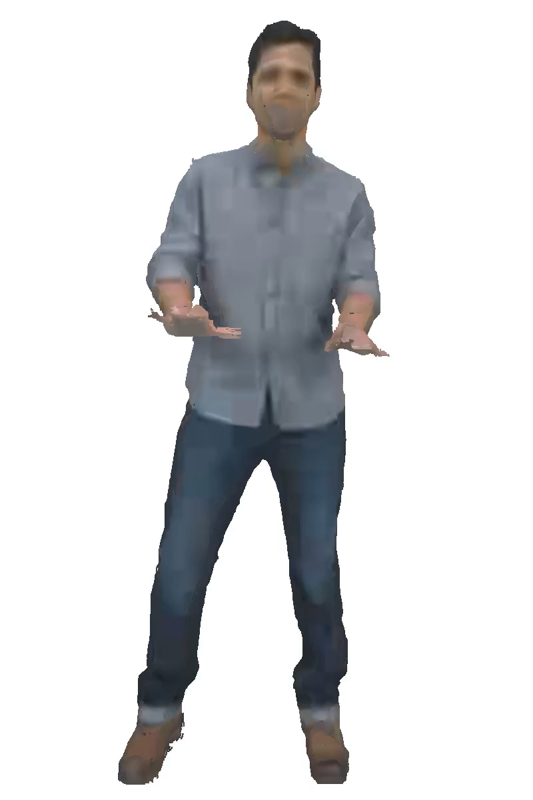
bit-rate = 2.8 Mbps
bit-rate = 1.8 Mbps
Notes:
Play a video of (e)

Slide 13

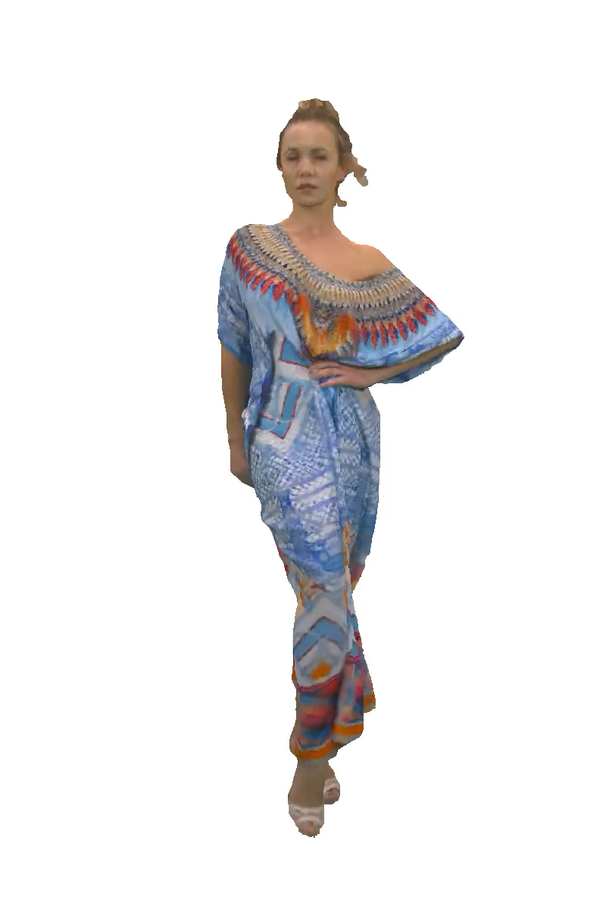
Our Contribution
V-PCC
same bitrate
better quality
Our method
In this work, we show that it is possible to improve the quality of V-PCC encoded point clouds at low bit-rate

Slide 14
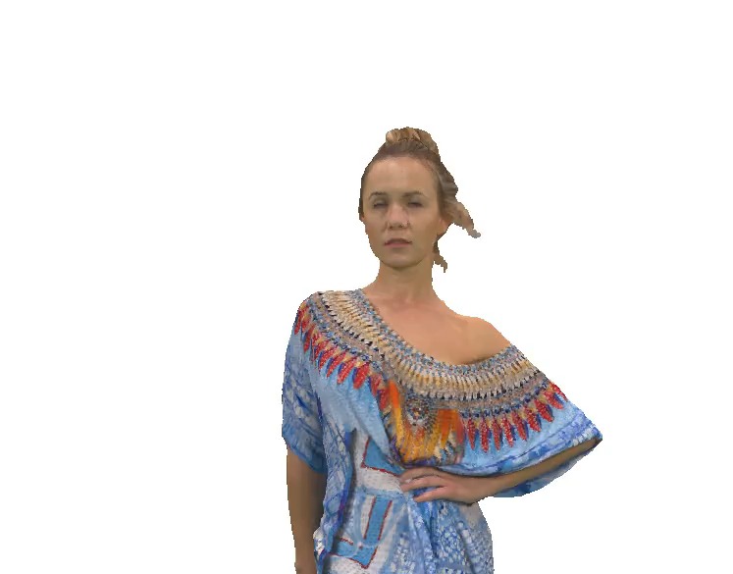
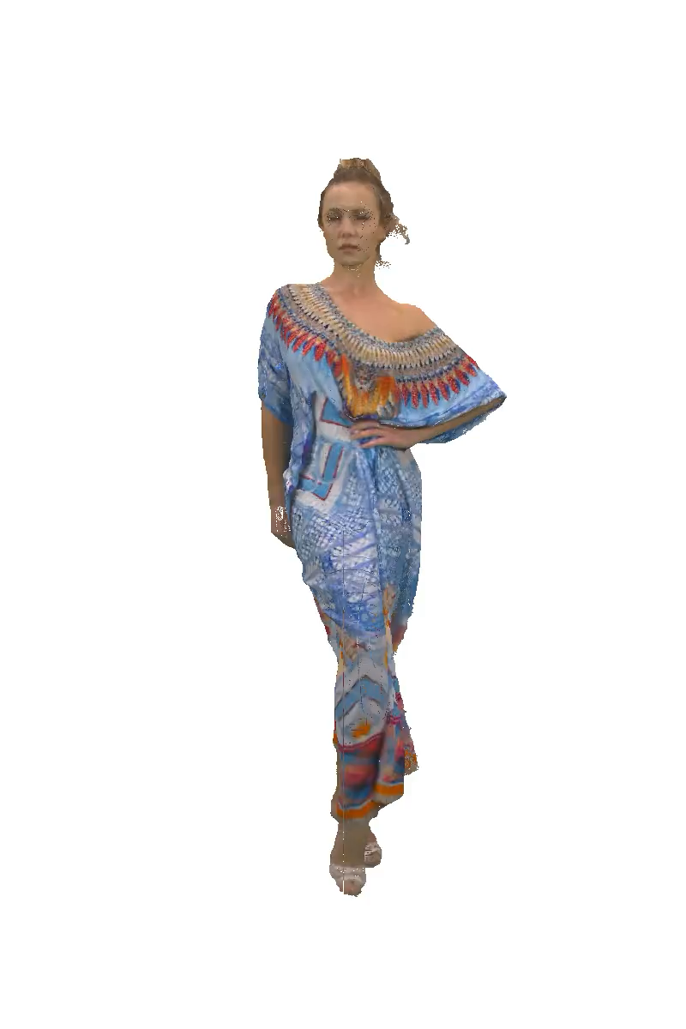
Intuitions
Original
Down-sample
Up-sample
Notes:
Zoom-in version
Figure: Original -> downsample -> upsample, show that upsample version is similar to original version in 2D

Slide 15
Intuitions
Exploiting redundant information among the points in the 3D domain
Overall, we can obtain better rate-distortion trade-offs on the rendered images of the point clouds
Down-sample
Up-sample
save bit-rate
V-PCC
Notes:
Zoom-in version
Figure: Original -> downsample -> upsample, show that upsample version is similar to original version in 2D

Slide 16
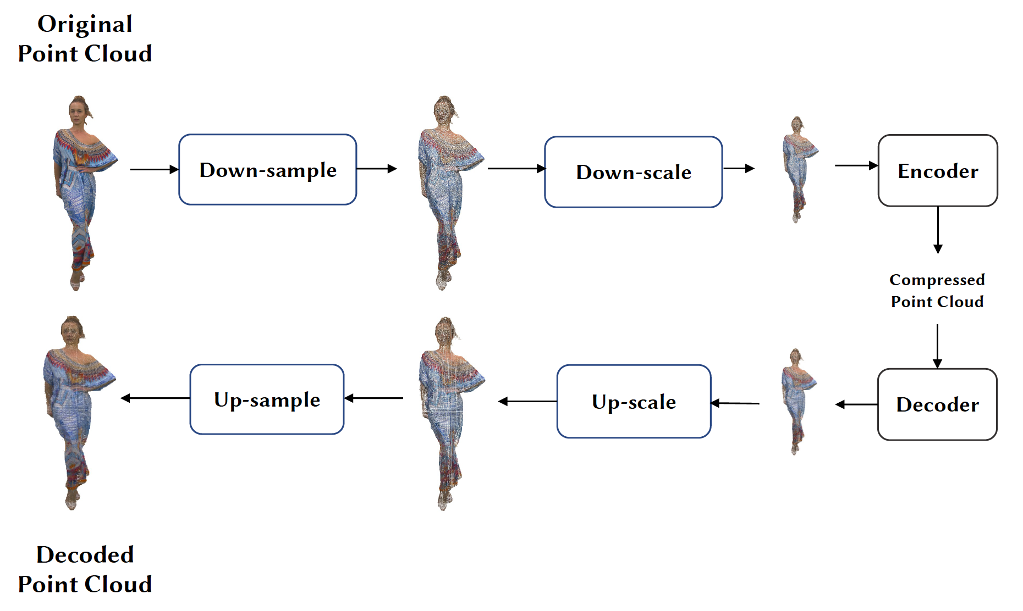
Pipeline of Our Method

Slide 17
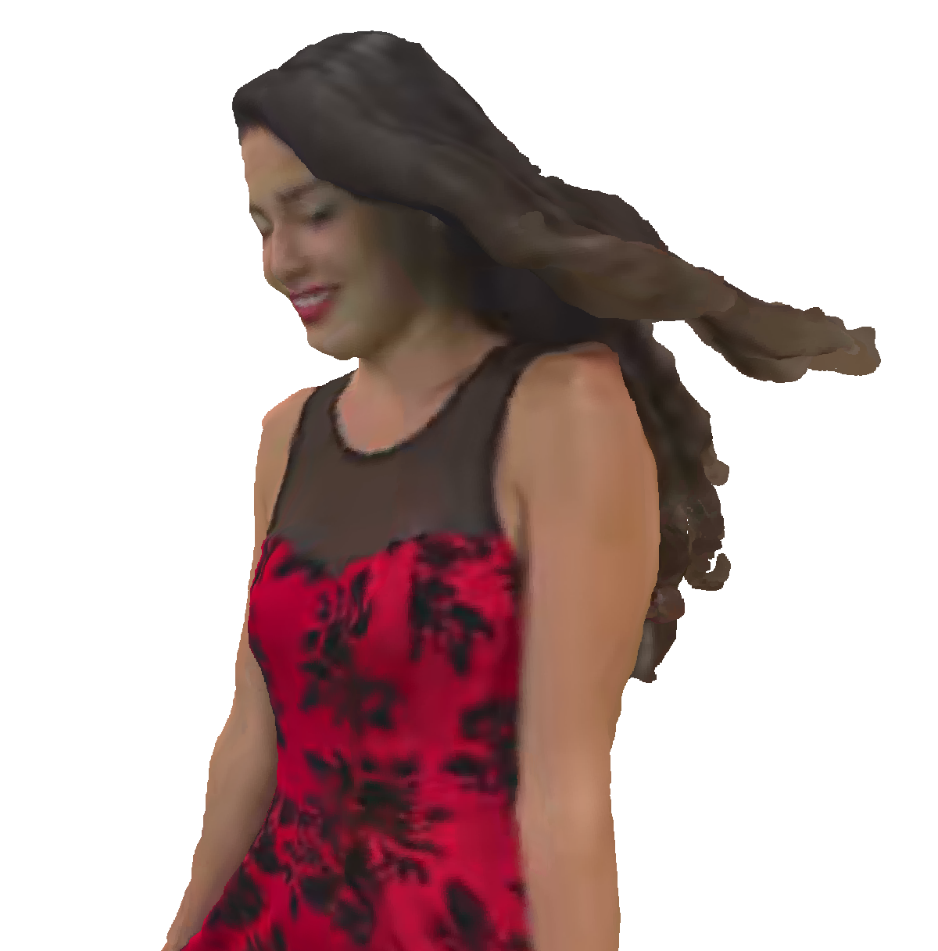
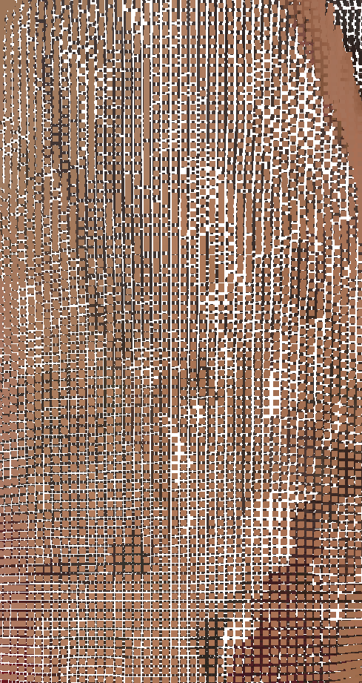
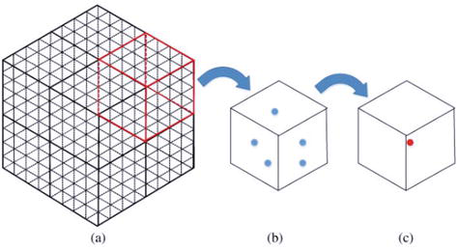
Down-sampling
Cause:
Each point is likely to have similar attributes with its neighbouring points
MPEG point-cloud compression standards require that point cloud coordinates to be quantized to integer values
Method:
Voxel down-sampling
Endowing the unorganized point cloud with richer spatial information and spatial correlation among occupied voxels
Notes:
Takes advantages of the discrete structure and the regular division of 3D space, endowing the unorganized point cloud with richer spatial information and spatial correlation among occupied voxels

Slide 18
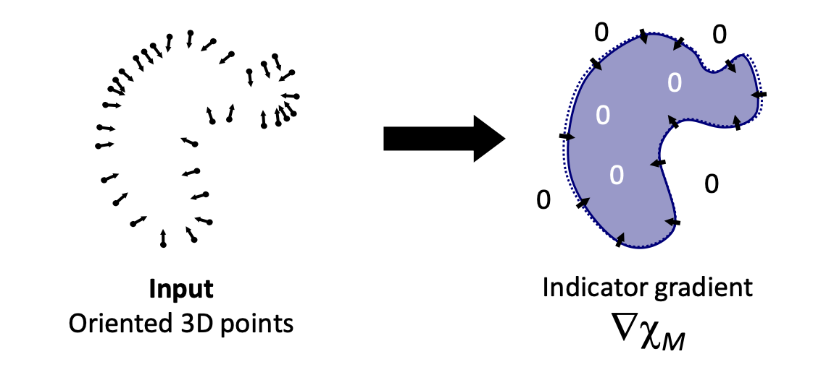
Up-sampling
Cause:
Point clouds are distributed in a non-uniform manner and have noise/outliers
Method:
Screened Poisson surface reconstruction (SPSR)
SPSR considers all the points at once, without considering heuristic spatial partitioning or blending. This property makes SPSR highly resilient to noise.

Slide 19
Scaling
Cause:
V-PCC as projection-based coding, is not efficient to deal with sparse point clouds
The errors introduced from projection will further degrade the quality of reconstructed point clouds
Method:
Down-scaling
Generate dense 3D point clouds by resizing the down-sampled point clouds using the centroid of the point cloud as the centre
down-scaling
V-PCC
Notes:
V-PCC as projection-based coding, is not efficient to deal with sparse point clouds because projecting sparse point clouds to planes will result in serious artifacts along the surfaces, degrading the effectiveness and efficiency of 2D compression codecs. Besides, the errors introduced from projection will further degrade the quality of reconstructed point clouds.

Slide 20
Experiments
Dataset
8i Dataset: (i) RedAndBlack, (ii) Loot, (iii) Soldier, and (iv) LongDress
Down-sampling
Remain 10% (𝑆 = 0.1), 30% (𝑆 = 0.3), 50% (𝑆 = 0.5), 70% (𝑆 = 0.7) points
Metrics
PSNR (peak signal-to-noise ratio),
SSIM (structural similarity index),
VMAF (video multimethod assessment fusion)

Slide 21
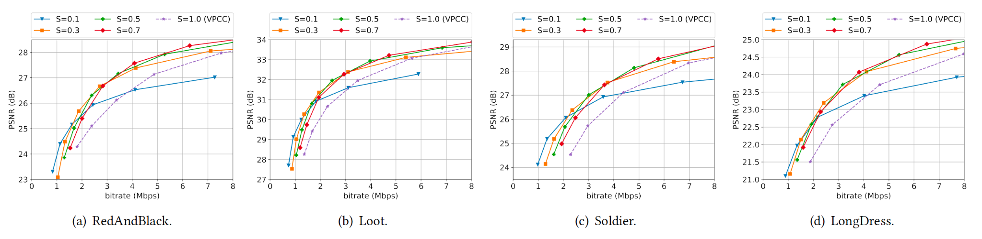
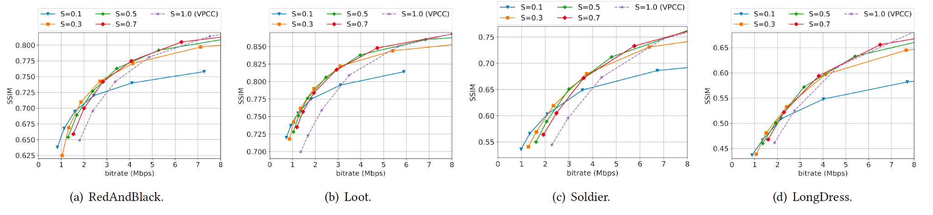
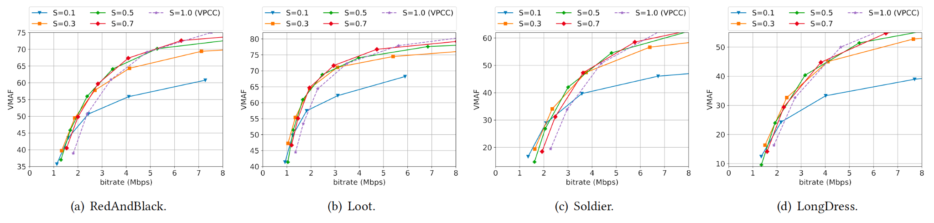
PSNR
SSIM
VMAF

Slide 22
PSNR
SSIM
VMAF

Slide 23
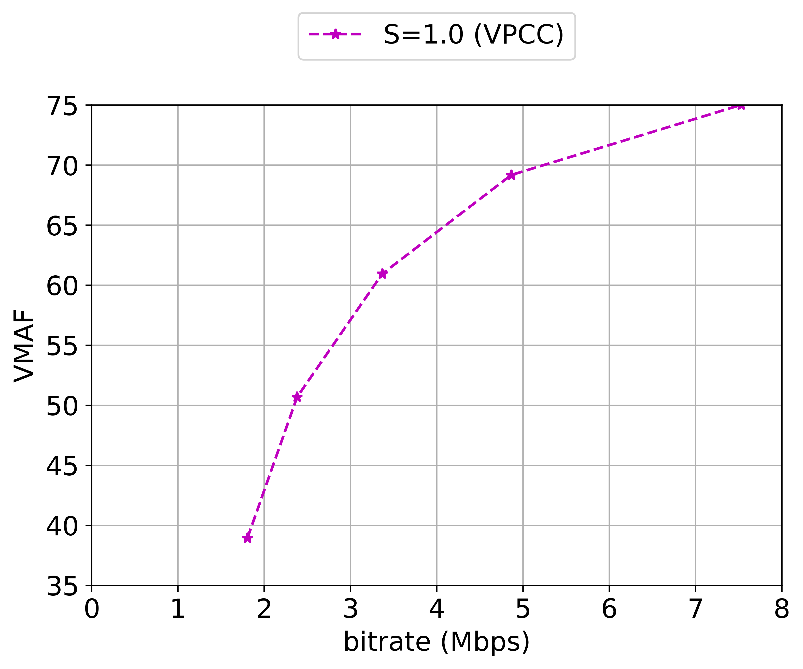
Results –– RedAndBlack
Notes:
Re-plot, show one by one (animation), step by step.

Slide 24
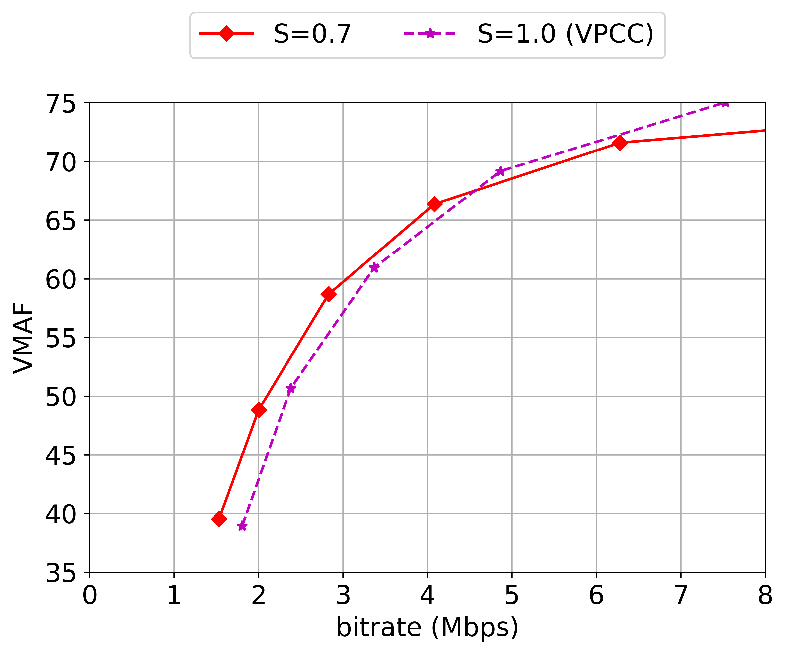
Results –– RedAndBlack
Notes:
Re-plot, show one by one (animation), step by step.

Slide 25
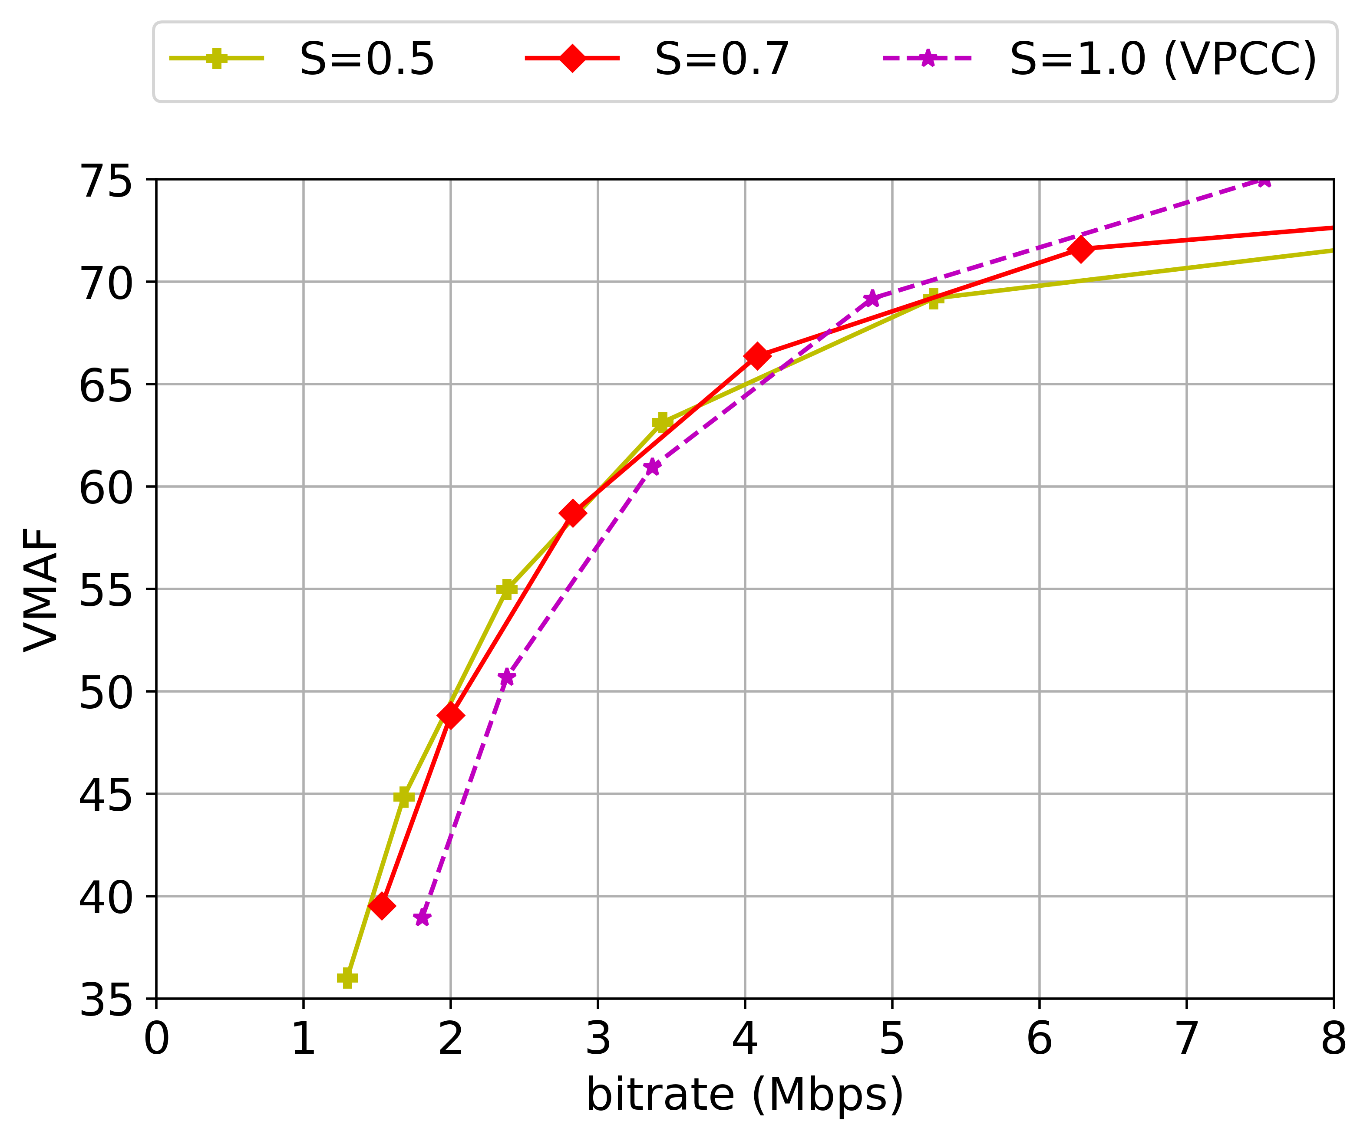
Results –– RedAndBlack
Notes:
Re-plot, show one by one (animation), step by step.

Slide 26
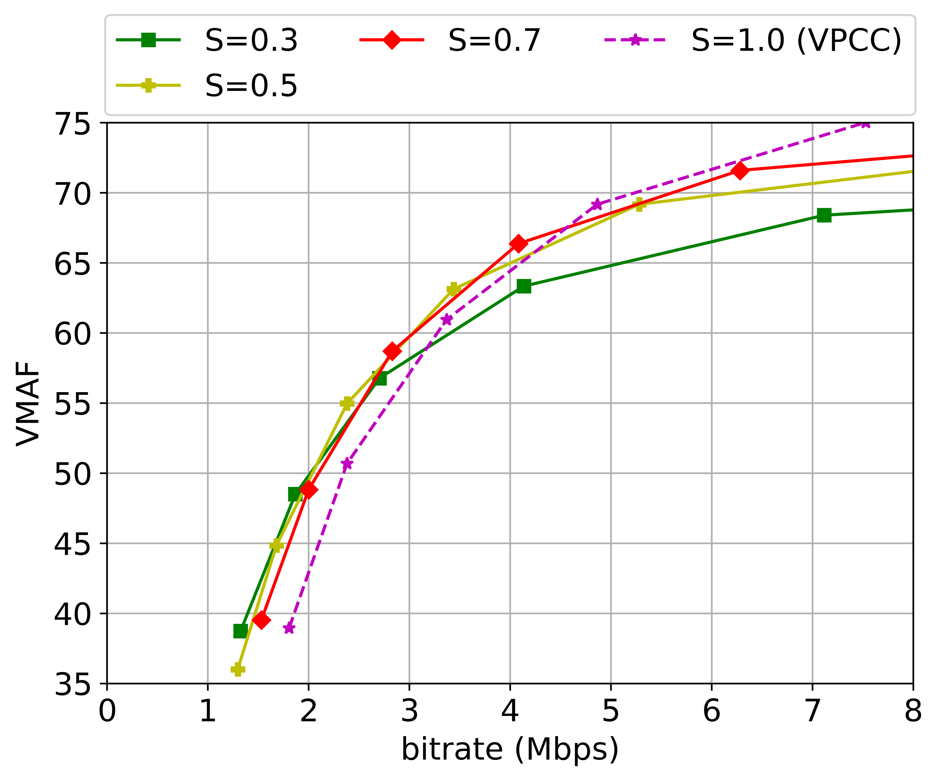
Results –– RedAndBlack
Notes:
Re-plot, show one by one (animation), step by step.

Slide 27
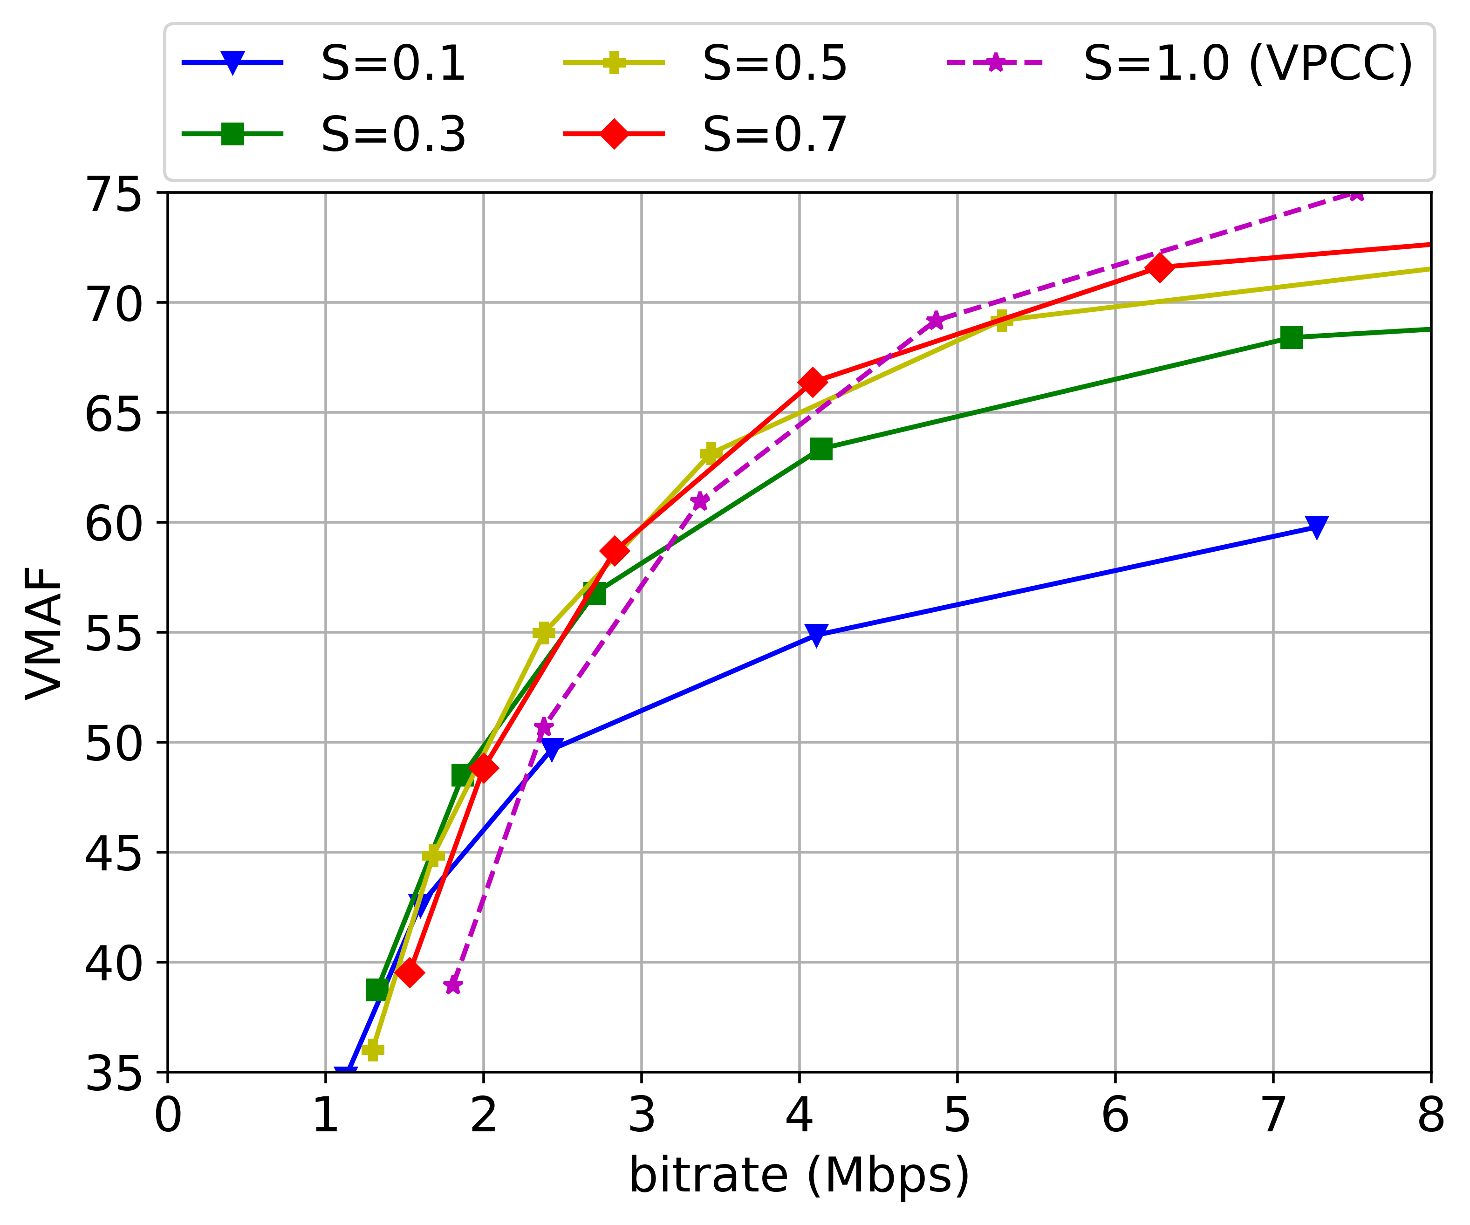
Results –– RedAndBlack
Notes:
Re-plot, show one by one (animation), step by step.

Slide 28
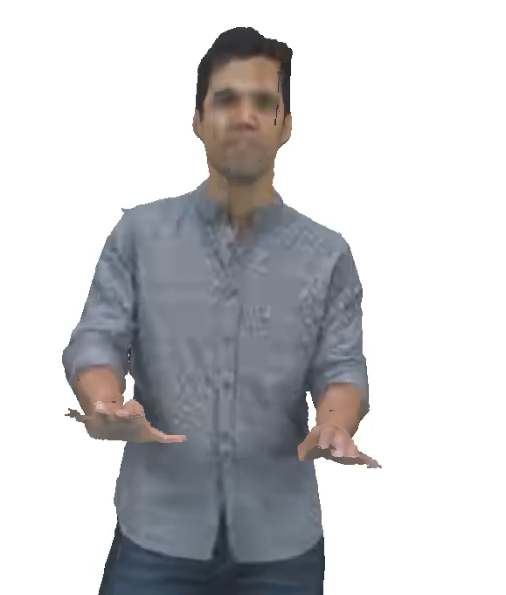
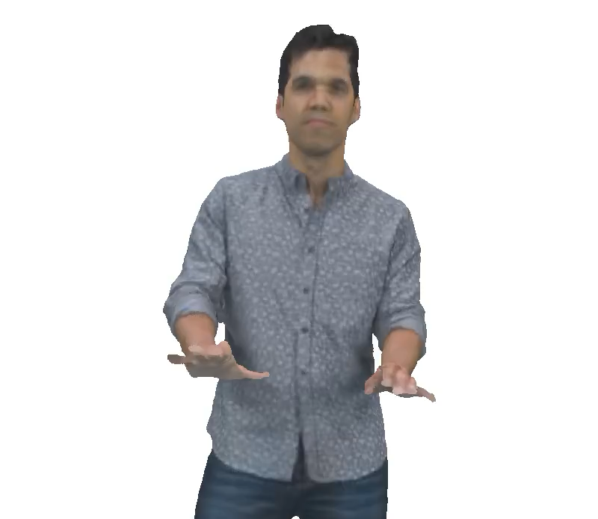
4.6 Mbps
𝑆 = 0.7
2.2 Mbps
𝑆 = 0.7
V-PCC
Our Method
V-PCC
Our Method
up to 2.1 dB in PSNR, 7.1% in SSIM, 14.8 in VMAF
Notes:
Bitrate and S value.

Slide 29
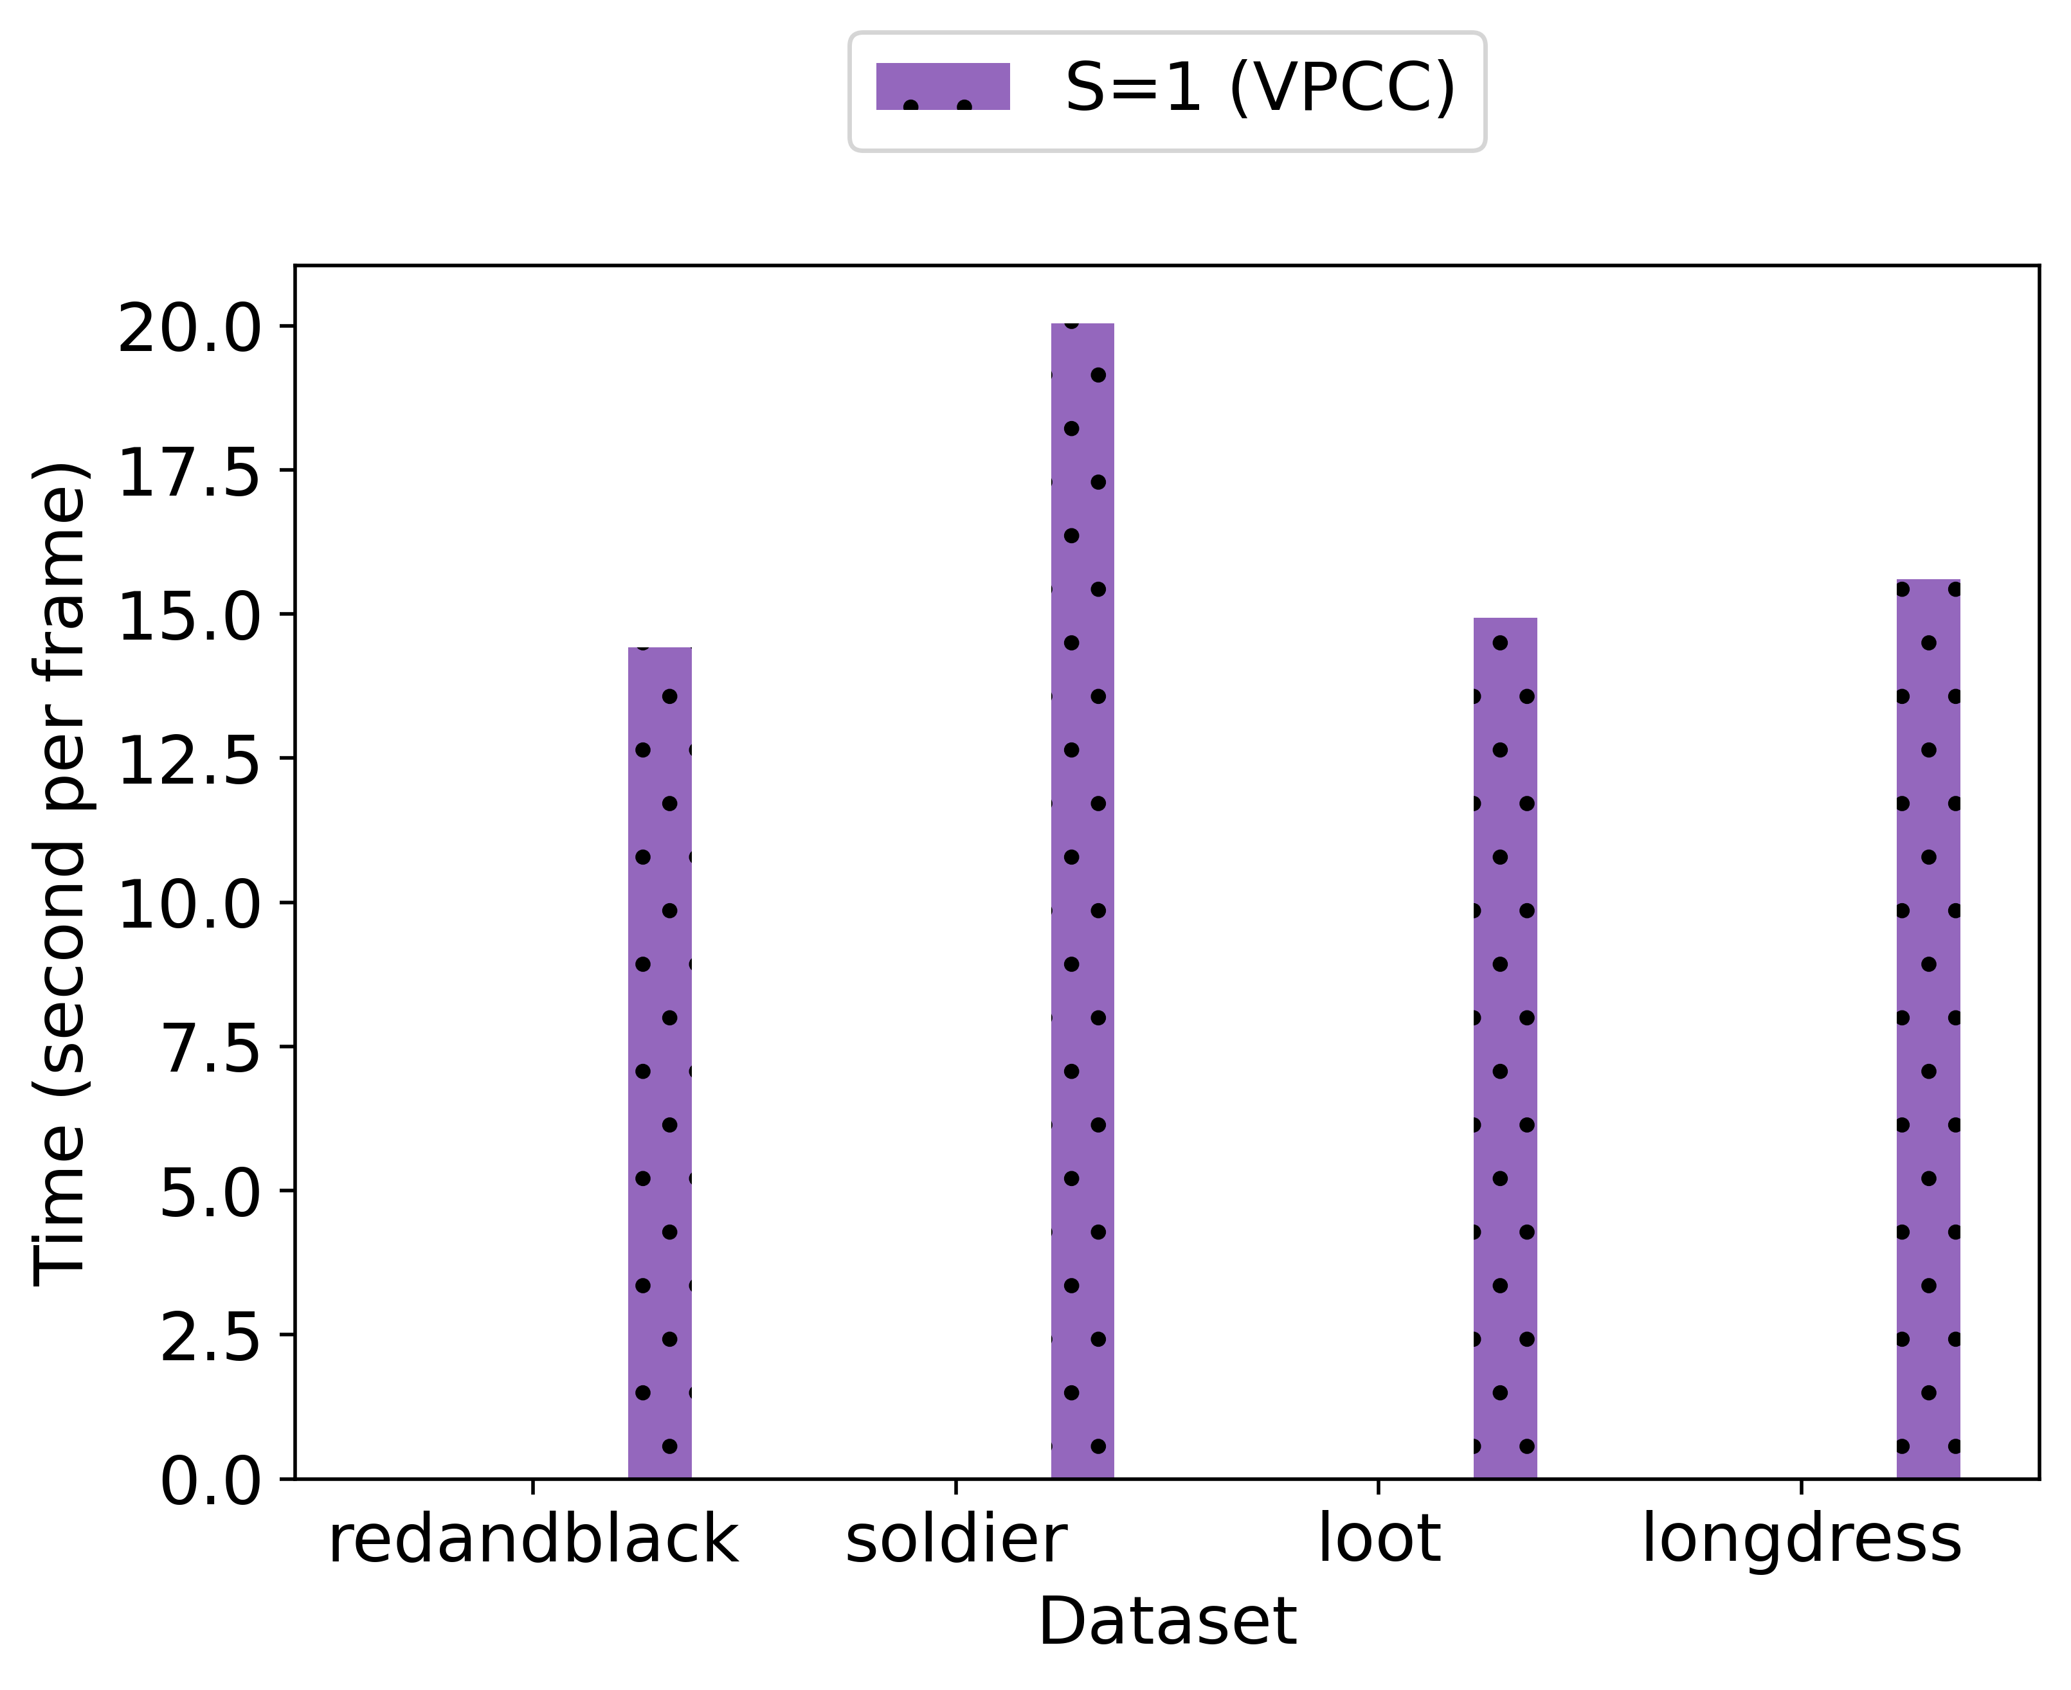
Computational Time
Notes:
Principle: do not show things at once.

Slide 30
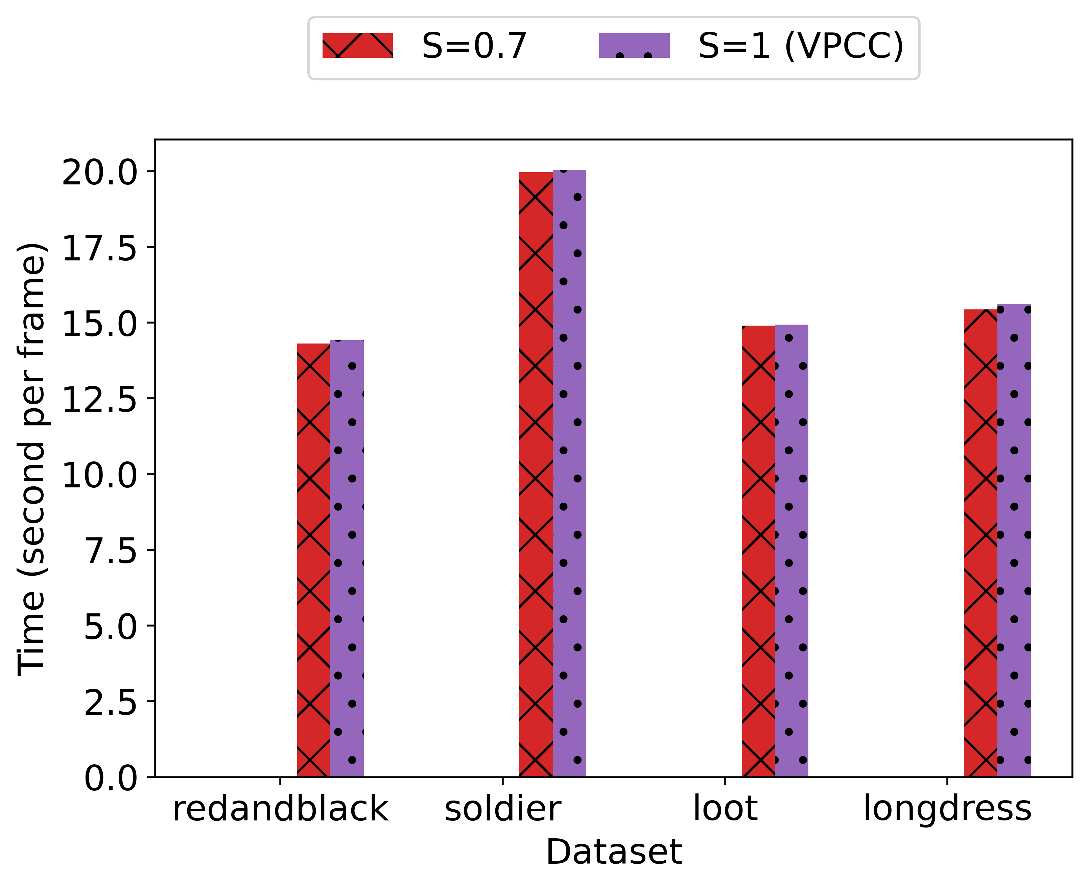
Computational Time
Notes:
Principle: do not show things at once.

Slide 31
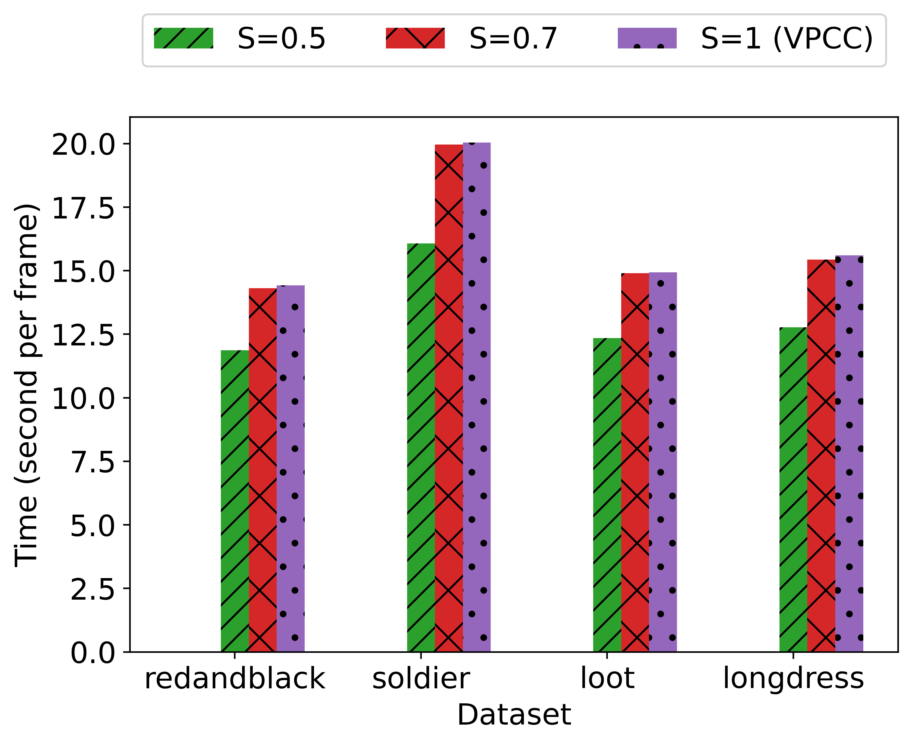
Computational Time
Notes:
Principle: do not show things at once.

Slide 32
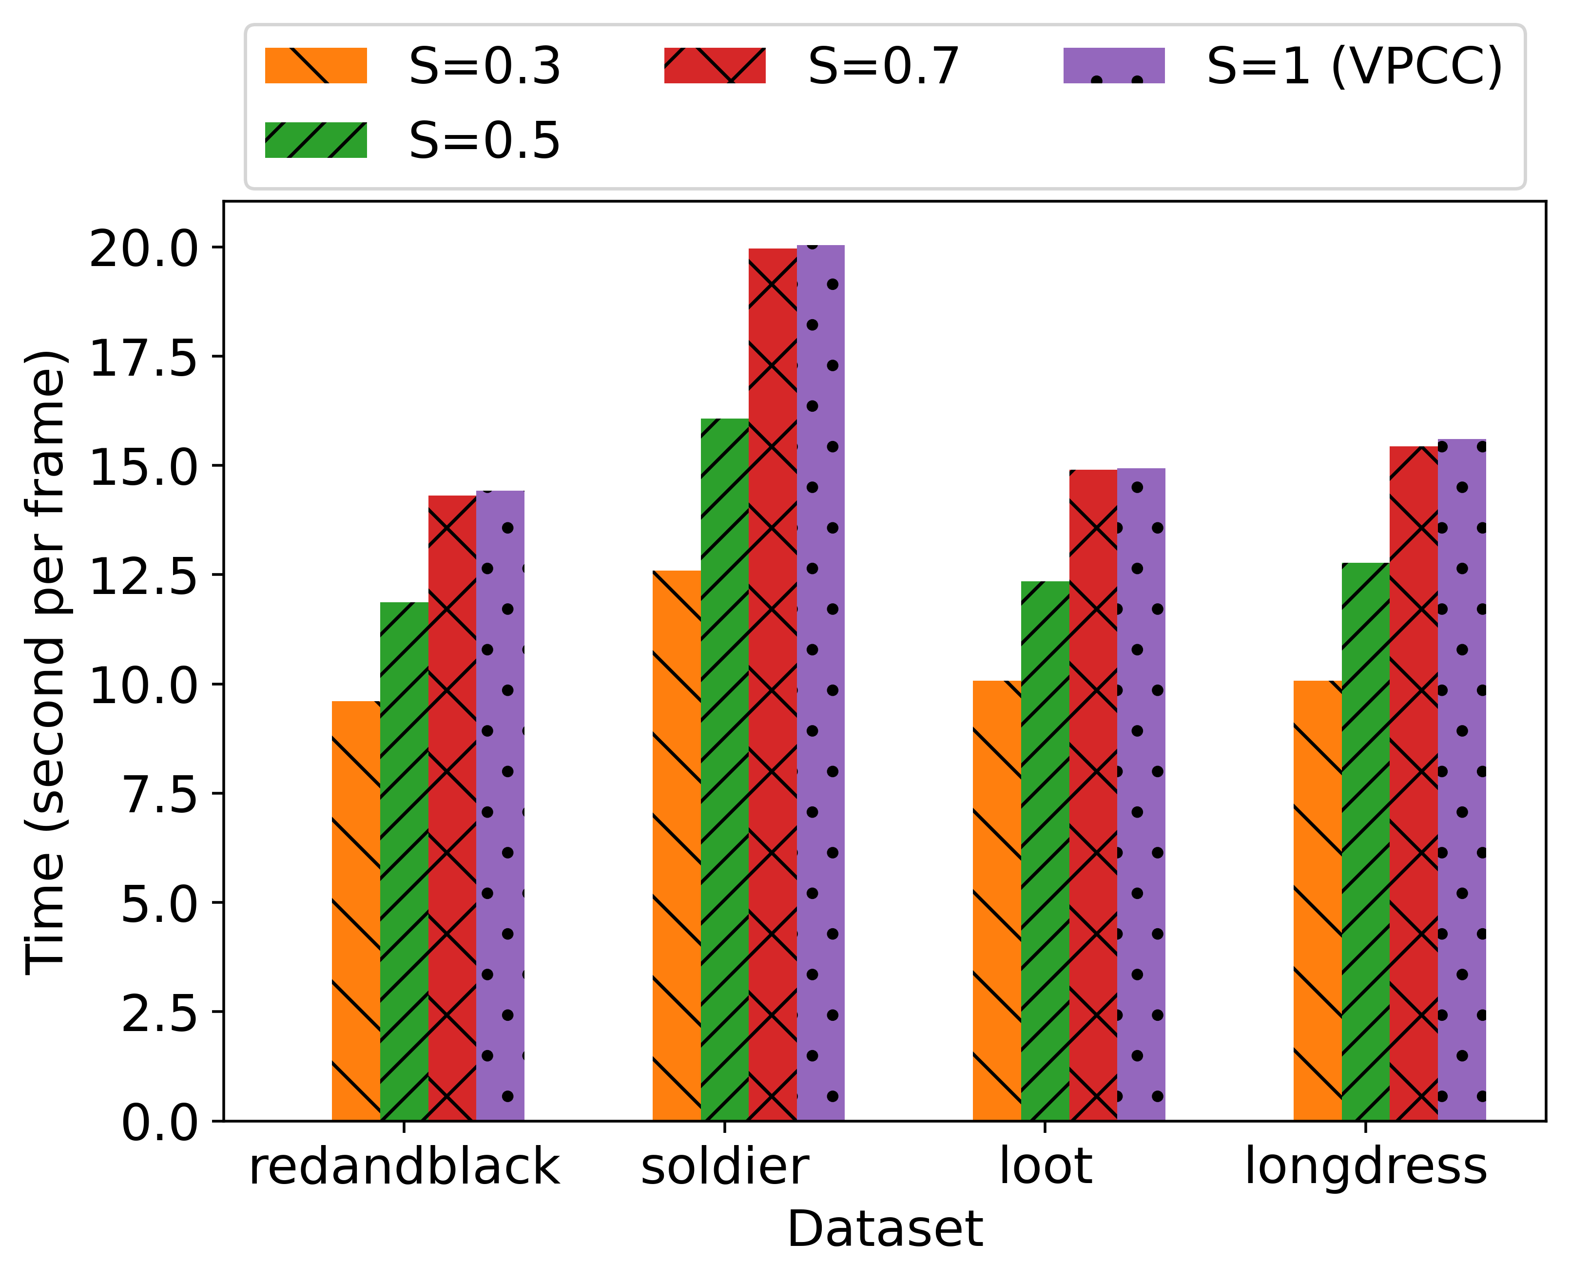
Computational Time
Notes:
Principle: do not show things at once.

Slide 33
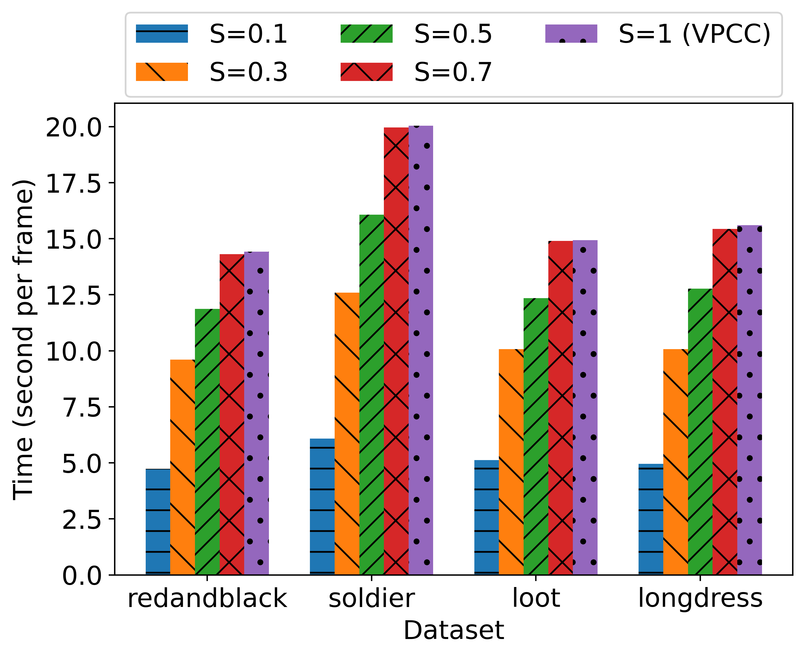
Computational Time
Notes:
Principle: do not show things at once.

Slide 34
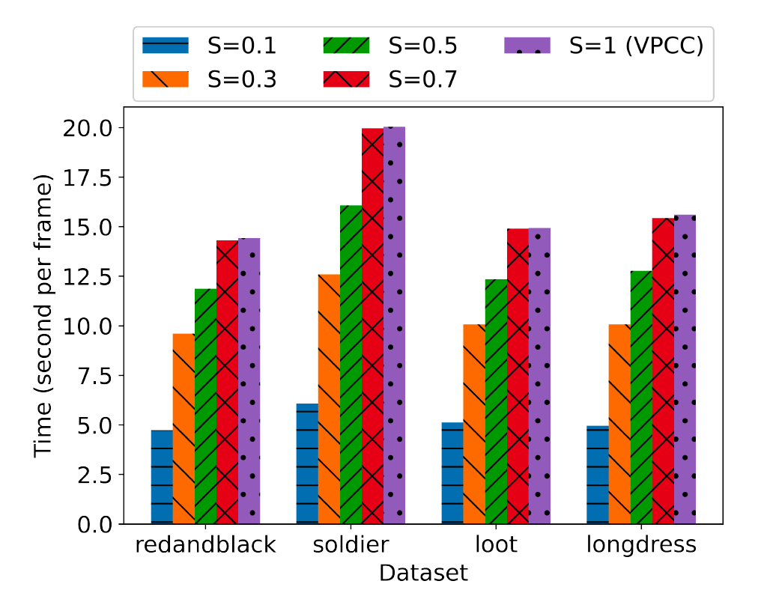
Computational Time
Our method is always faster than V-PCC
The computational overhead of SPSR is compensated by the computational saving due to reduction in number of points in the encoded model
Notes:
Principle: do not show things at once.

Slide 35
Conclusion
MPEG’s V-PCC has demonstrated superior performance
However, V-PCC reliance on video codec is its Achilles’ heel
We show that by combining geometry-based processing & 2D video compression, we can improve the 2D rendering quality at a low-rate scenario by up to 2.1 dB in PSNR, 7.1% in SSIM, and 14.8 in VMAF

Slide 36
Future Directions
Apply adaptive down-sampling
lower down-sampling rate on regions of 3D point clouds with more important and intricate geometry information (e.g., the face)
higher down-sampling rate on regions with smoother surface.
Provide guidance on how to set the value of 𝑆, the down-sampling ratio, for each bit-rate range that we wish to target

Slide 37
Thank you!!!
Yuang Shi, Pranav Venkatram, Yifan Ding, Wei Tsang Ooi
School of Computing
National University of Singapore
Notes:
Use keynote/ppt

Slide 38
2D V.S. 3D
A commonly used approach to encode a 2D video at a lower bitrate is to down scale the 2D frames by down-sampling the 2D pixels before encoding.
Video Encoder
2D video encoder, e.g. HEVC / VVC
packed patches
down-sampled patches

Slide 39
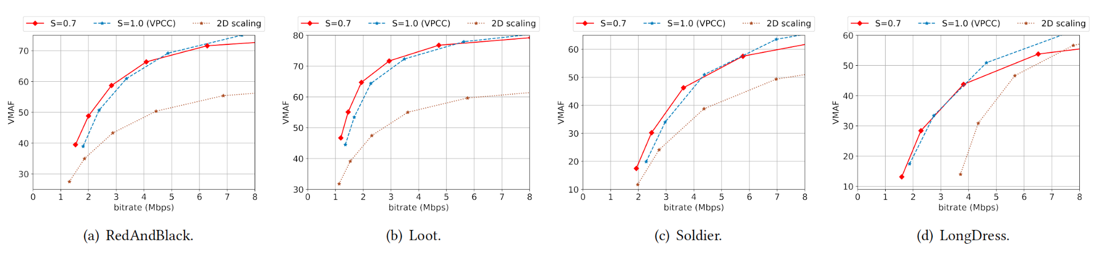
2D V.S. 3D
Results show that reduces the quality in 3D domain is more effective to achieve better 2D quality at low bit-rate.

